Slide 1
For today’s exercises & your own copy of the slides, please visit:
https://bit.ly/Feb8_Cloud4Virologists

Slide 2
Introduction to NCBI Cloud Computing for Virologists
Cooper J. Park, PhD
Notes:
Welcome to today’s workshop “Intro to NCBI Cloud Computing for Biologists”, I’m your host/presenter Cooper, and I’m being helped with the technical side of things by Wayne Matten, Rana Morris, etc.

Slide 3
Outline
What is the Cloud
Objective 0 - Logging In & Creating an S3 bucket
Today’s Story
Objective 1 – Consensus Sequences from SRA reads using EC2 instances
Objective 2 – Search SRA metadata using Athena
Objective 3 – Visualize Sequence Alignments using the NCBI Sequence Viewer
Wrap up & Billing
Notes:
The outline for today is pretty straightforward: We’ll start off with this introduction that I’m giving you now and cover some basics about what the CLOUD is/does, and then jump into our hands-on exercises. Don’t worry, we’ll also have a few breaks scattered throughout! At the end, we’ll tie everything together and also talk about how you can pay me for the workshop today... Just kidding! Billing means we’ll go over the most popular question in cloud computing “How much does it cost”.

Slide 4

What is “The Cloud”
Notes:
So, the first thing we should probably address before we dive into some exercises is what exactly “the cloud” is. For a long time I viewed the concept of “The Cloud” as this almost magical entity that only really advanced technical people could use. I think everyone has an understanding that the Internet is involved, but they don’t really know what it means to “use” the cloud. So, let’s talk about what the cloud actually is.

Slide 5
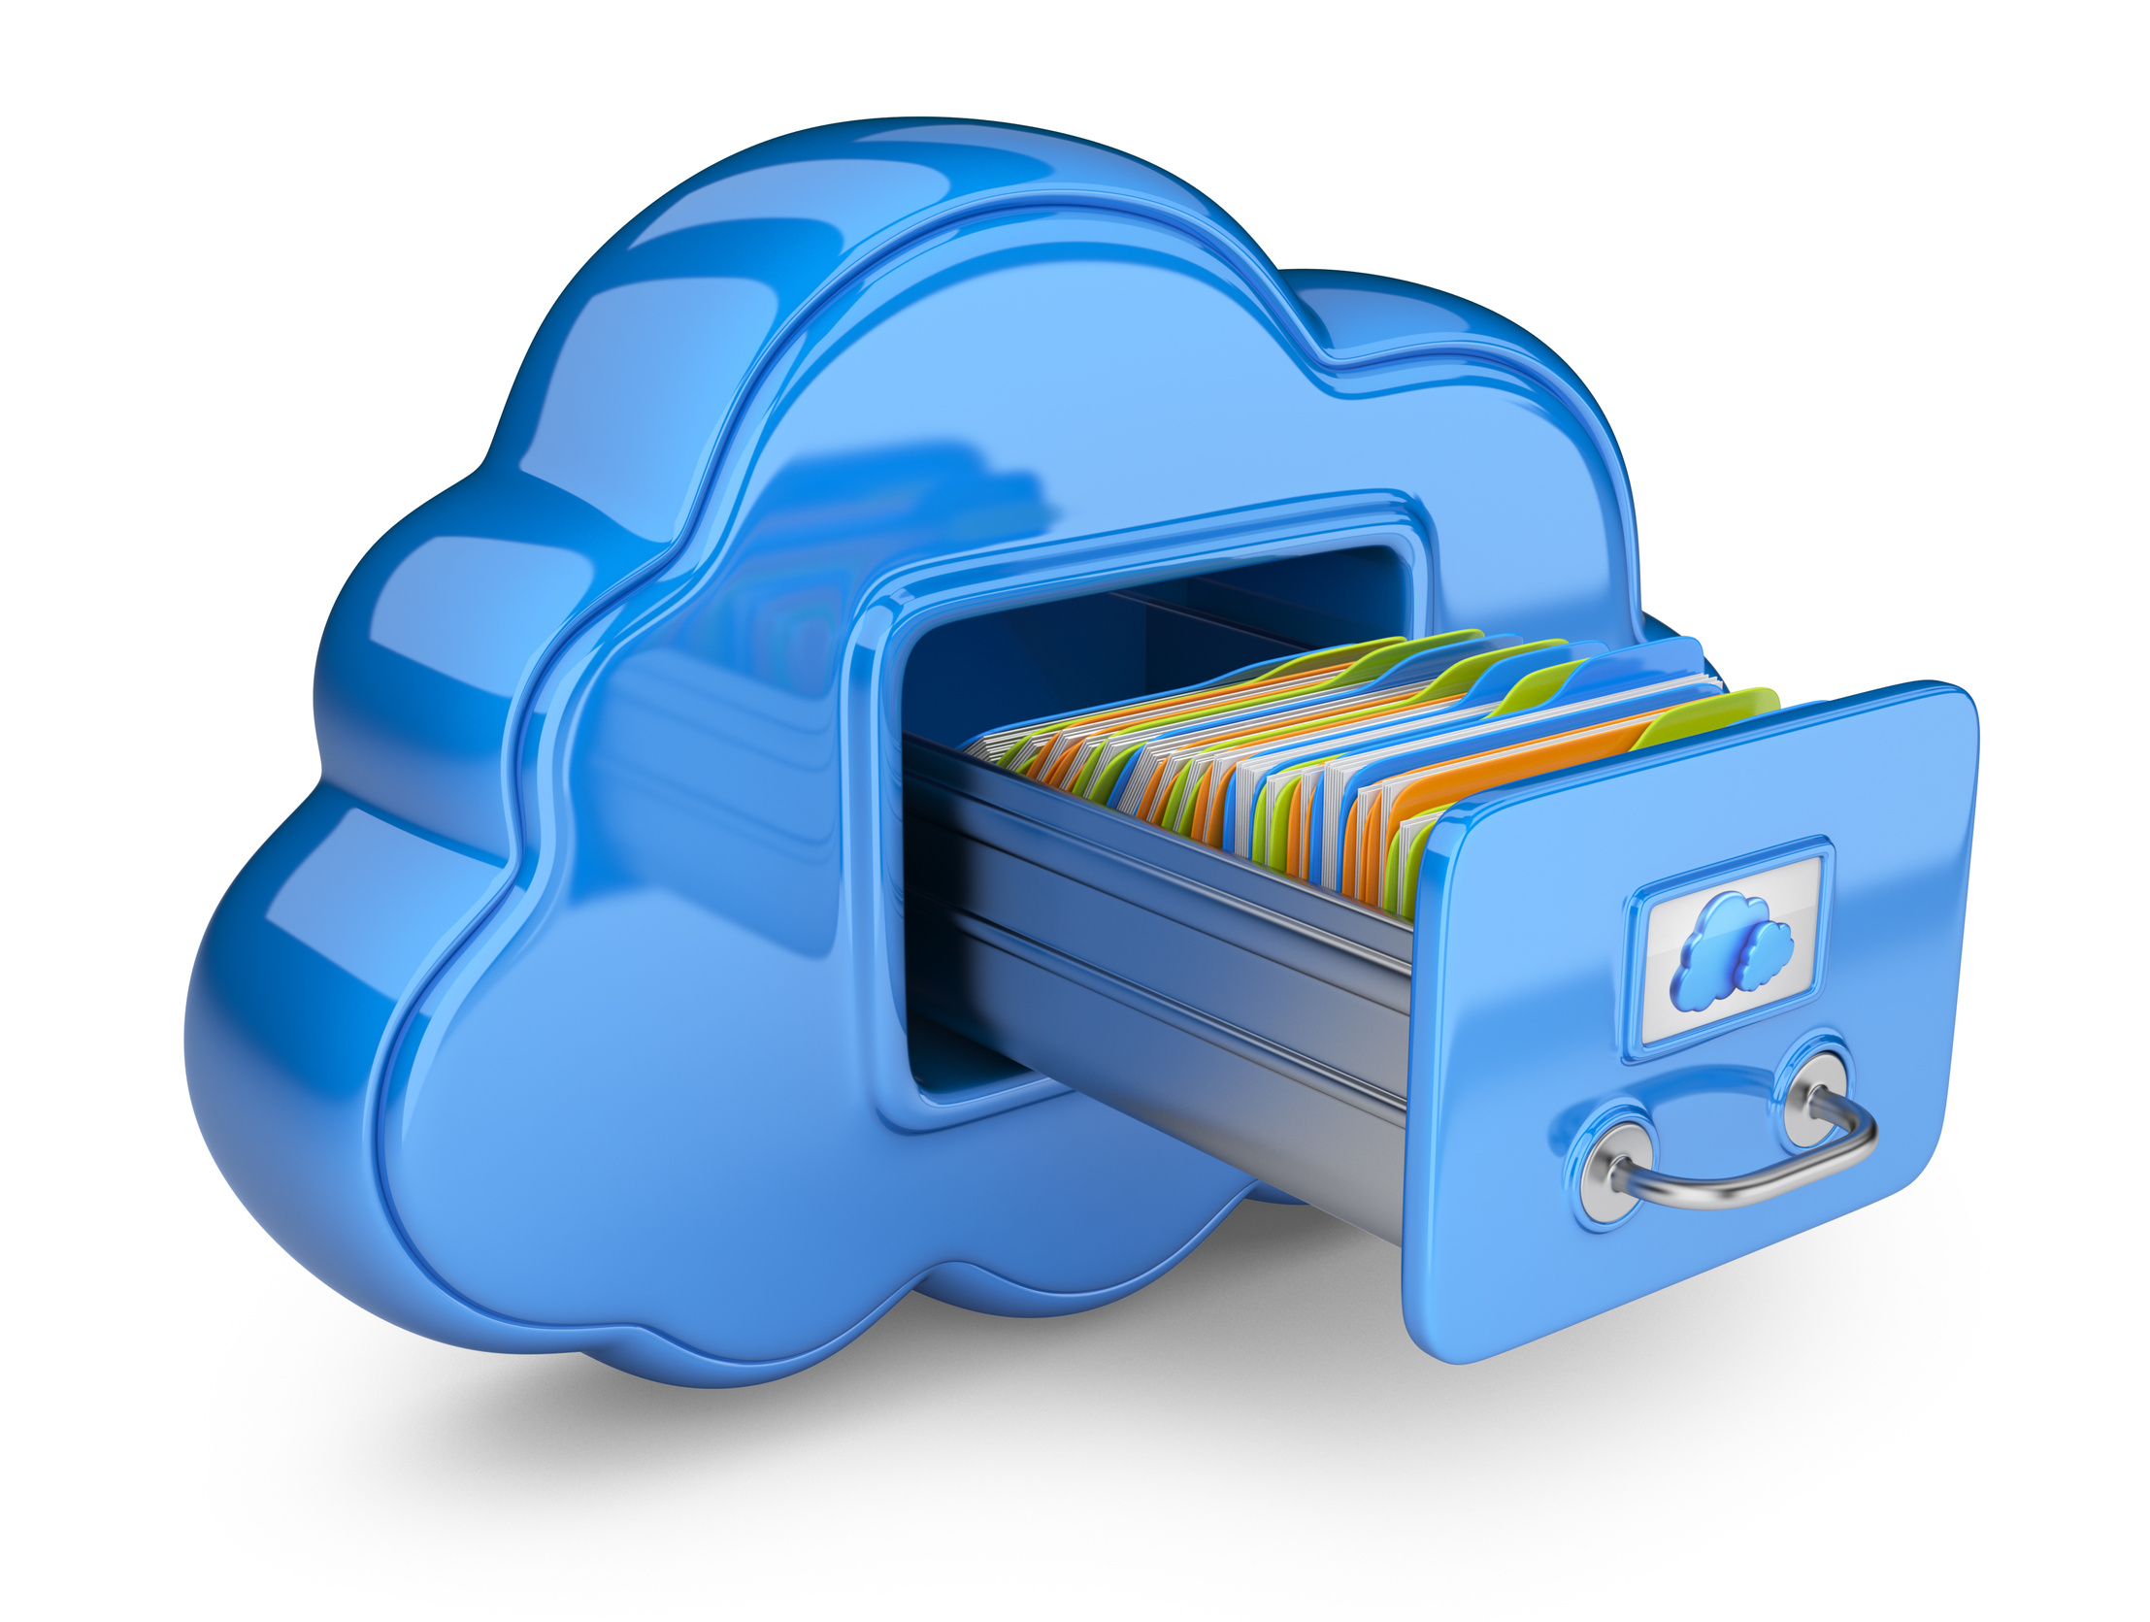


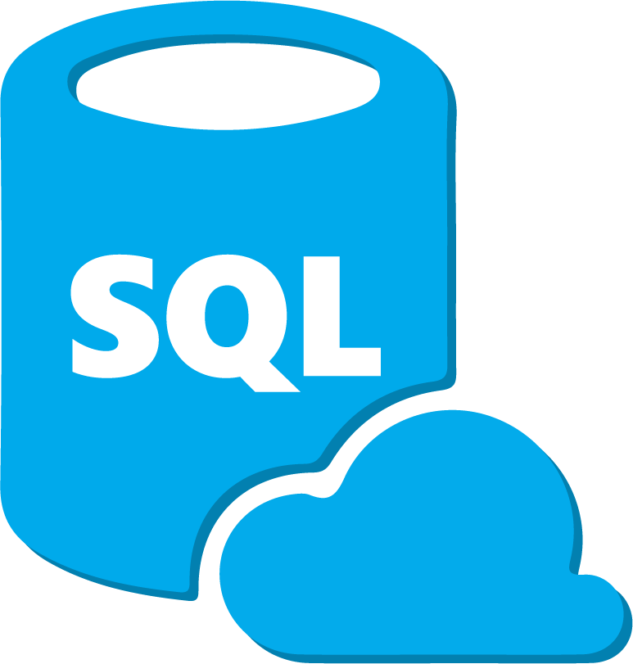

A “one-stop shop” for high-demand computing services delivered across the internet
“The Cloud”
Compute Power
File Storage
AND MORE!
Database Management
Data Sharing
Notes:
The Cloud is basically an all-encompassing term for a “one-stop shop” of different computing services and technologies that a company will offer over the internet to help people manage and process their data. We’ve probably all had a scenario where we are trying to run a program, or open a file, and that little fan in our laptop starts going crazy and the screen freezes up and we think “Gah, I wish I had a better computer!”. Well, the cloud offers us the ability to just “rent” a better computer to do the work we need. For example, you can literally buy more processing (or compute) power so you can manage those laptop-freezing sized files very rapidly. Of course, when you’re done, you can also store that data in the cloud. You’ll also see later in this workshop how we can manage that data in a database to make retrieving or filtering that data very convenient. And perhaps one of the most important aspects of the cloud is the ability to easily share that data with other researchers or members of your own team. And of course, there are so many more services that can be offered that describing them would be a workshop by itself!

Slide 6
POLL!
Which aspect of your own computational research slows your progress down

Slide 7
Reasons to use the cloud
Cost
Pay only for what you use
Often cheaper than managing your own infrastructure
2) Global Access
- Data can be shared and accessed seamlessly on a global scale
3) Speed and Performance
Resources can be optimized for specific needs
Workflows can be scaled to meet demand
New technologies/services constantly developed and immediately available
4) Reproducibility, Security, and Reliability
Easily back-up, protect, version control and recover crucial data
Computing environments can be saved with 3rd party tools to replicate workflows
Notes:
Well, as you might suspect, given that you decided to be at the workshop today, the world of Cloud computing offers a number of benefits that can address all of those pain points we were just exploring. So let’s talk about these benefits a bit more in depth.
First, the cost. Most folks actually find this to be the most intimidating factor of trying out cloud computing, but it’s actually very affordable. For example, one of the biggest advantages is that you only have to pay for the resources you use. There is no “subscription fee” or down-payment necessary to get into the cloud. Simply find the resource you want to use, jump in, and you can get a bill later on for only exactly what you took advantage of. Additionally, because these services are offered to a global audience, the companies that offer these services can bring them at very competitive rates that rival, or often times beat, you trying to invest in your own computer infrastructure. Not to mention the effort you save by not having to deal with your own infrastructure!
Next, is the accessibility of cloud resources. Any data you generate or store in the cloud can easily be shared with people across the globe. This is great for research collaborators, or even groups like us here at NCBI who want to make sure people can get access to the data they need as soon and as easily as possible.
Reason #3, you can get your work done faster. Every cloud service I have used offers MANY customization options to optimize the service to fit your needs, including even managing the cost of the service. But, if you find yourself with an influx of data, or a new project that needs extra resources, it’s a very easy task to scale your cloud service up to meet those demands. Plus, these cloud provider companies are constantly developing new tools and software that may end up helping you even more.
And lastly, the cloud is extremely reproducible and reliable. Data storage services offer back-ups, version control, and more to keep your data secure. Additionally, the actual workflows you develop for your research can be easily packaged together and shared with colleagues to keep your work reproducible.

Slide 8

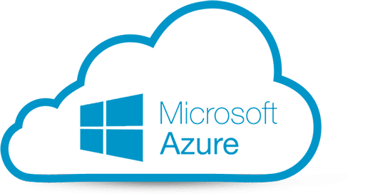

Meet your commercial cloud providers
Notes:
So when you decide to get into cloud computing, chances are high that you will at least start with one of these 3 commercial Cloud providers, Google Cloud (GCP), Microsoft Azure, and Amazon Web Services (AWS).
As an institution, NIH has a partnership with all three of these providers for current and future data collaborations. For this workshop, we’ll be using the Amazon, or AWS, platform to do our cloud exercises. So let’s go over what NCBI and AWS have worked on so far.

Slide 9
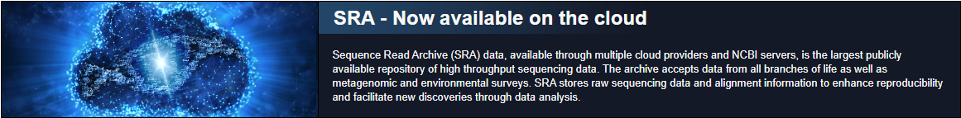
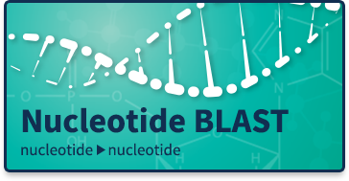
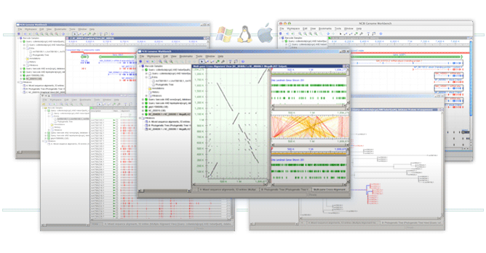
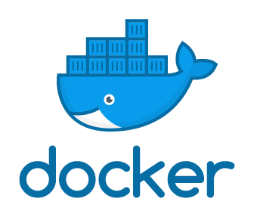
NCBI and the Cloud
Genome Workbench
Notes:
Perhaps the biggest contribution NCBI has made to world of cloud computing is making the SRA database publicly available on the AWS and GCP cloud platforms. Specifically on AWS, all 10 Petabytes of data are available for free access from the AWS Open Data Program. Now to access that data, AWS has their own tools to interact with it, so we’ll get into at least one of those later in the workshop.
Additionally, NCBI has created cloud-friendly versions of many of the most popular software packages. BLAST and its many different variants exist as downloadable programs, plus them and many other programs have also been packaged into Docker containers which allows anyone to deploy an reproducible computing environment right to the cloud for consistent and accurate analyses of their data.
Finally, a newer product, the Genome Workbench, provides a visualization option for your data, especially when comparing it to data stored in NCBI.

Slide 10
Objective 0 – Logging in to the AWS Console Page & Creating an S3 bucket
Notes:
But before we do ANY of that, we need to get everyone logged into their cloud accounts. Once you are all logged in, we are also going to immediately setup our first cloud service called an S3 bucket. So before I give you all the login credentials let’s talk about what an S3 bucket is.

Slide 11

S3 Bucket (aka: “Storage”)
S3 buckets are the “hard drive” of your cloud computer
Designed for long term storage of files and easy sharing
Pay for what you use
Price increases with storage size/duration and data transfer rates
Today’s S3 is free!
Notes:
You can think of an S3 bucket as the “hard drive” of our cloud computing environment. This is designed for the long-term storage of data and results from your analyses that you can access anytime/anywhere for incredibly tiny costs compared to storing the data on other services (we’ll talk more about those other ways in the next objective). From a pricing standpoint, the cost to keep data in the S3 bucket is determined by two things; the amount of data you keep in the bucket, and the number of times you move files in/out of the bucket. However, it is so cheap to maintain data here that for today’s workshop our S3 buckets will essentially be free because of how little time we will be using it and how little data will be moving through it.
That being said, EVERY piece of data we generate today will find it’s way into this S3 bucket during the workshop. So, it’s important that we set this up immediately after logging in. Speaking of, let’s get everyone logged in!

Slide 12
Login Walkthrough
https://codeathon.ncbi.nlm.nih.gov
Username: “Email Prefix” (everything after the “@”)
Password: <See the chatbox>
Full Documentation at: https://bit.ly/Feb8_Cloud4Virologists
Notes:
If you can’t remember your username today, please send a Zoom chat message specifically to “Rana Morris – I’m here to help!” and she can get your username sent privately.

Slide 13
Outline
What is the Cloud
Objective 0 - Logging In & Creating an S3 bucket
Today’s Story
Objective 1 – Consensus Sequences from SRA reads using EC2 instances
Objective 2 – Search SRA metadata using Athena
Objective 3 – Visualize Sequence Alignments using the NCBI Sequence Viewer
Wrap up & Billing
Notes:
Okay, everyone is logged in and the S3 buckets are made, so now we can talk about what analyses we actually want to accomplish today.

Slide 14
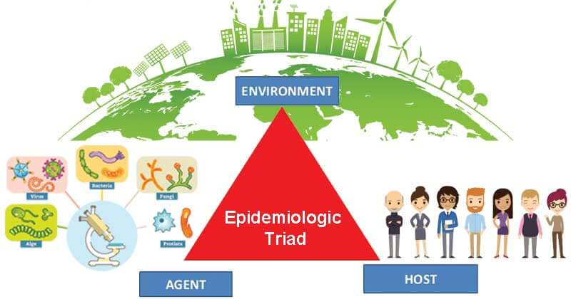
Case Study: Genomic Epidemiology
Community sanitation
Socioeconomic context
Health care availability
Genetic susceptibility
Nutritional health
Individual Behavior
General health (e.g., pregnancy, concurrent infections, etc.)
Pathogenicity
Virulence
Genotypic/phenotypic novelties
Notes:
Epidemiology is the study of the patterns and dynamics of pathogens and disease. Anything that may boost/limit how a pathogen is spread is on the table for an epidemiologist to study whether its from the perspective of the pathogenic agent, the host, or the environment. In the pathogen, epidemiologists are particularly interested in concepts like its pathogenicity, meaning it’s ability to infect the host, its virulence, meaning the severity of the disease the pathogen causes once inside the host, and more recently, the genetic and phenotypic differences that set the pathogen apart from others. But beyond just the current genetic differences of the pathogen, epidemiologists have started to take interest in how that pathogen will evolve over time as well. Each unique mutation within the pathogen has the potential to alter the battle between pathogen and host during an infection. And given that these mutations can occur at any time, and often in rapid succession, one of the new, but major, challenges in modern epidemiology is rapidly identifying these novel mutations in new and ongoing pathogens and then rapidly predicting what the consequences of those mutations are. Now, if hearing my drone on about epidemiology makes you think “huh, that sounds a lot like what is going on with the Covid-19 pandemic”, well, you’d be 100% correct!

Slide 15
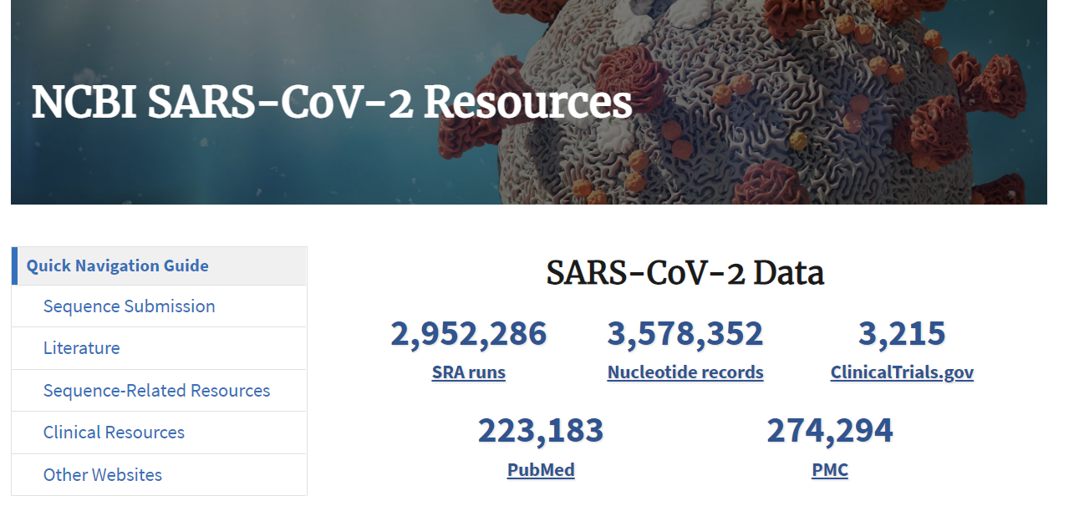
Case Study: Sars-CoV-2 Pandemic
Daily releases of new sequences to:
SRA (raw reads)
Genbank (assembled)
RefSeq Reference Sequence of Wuhan strain
Easy access via web, command line & cloud
Today’s Ultimate Goal: Identify novel mutations in a modern Sars-CoV-2 infection compared to the traditional “Wuhan” reference strain
Notes:
Thanks to cheap and globally distributed DNA sequencing efforts, we have an unimaginable deluge of sequence data dedicated to Sars-CoV-2, or Covid-19, that has tracked its evolution to a level of specificity that is basically unheard of in most organisms. This has created a treasure-trove of data for epidemiologists to study the evolution of the virus in real time and perform that genomic surveillance we have been talking about in unprecedented detail. Now for epidemiologists to get a hold of that data, it needs to be stored somewhere easily accessible. That’s where NCBI comes in. A lot of this sequencing data has actually been stored in NCBI across several databases like our Sequence Read Archive and the well-known Genbank. On top of that, NCBI researchers have also put together an excellent representative sequence for the original Wuhan strain which metaphorically kicked this pandemic off. It has become a staple in the epidemiological community as a template for which all subsequent variation can be compared to.
So what does all of this information mean for us in today’s workshop? Well, I thought it would be a fun exercise to simulate a very simple example of how epidemiologists use the data in NCBI to identify novel variations in freshly sequenced Covid-19 infections for deeper study. Of course, we will get into the details of what that involves as we go along, but the primary goal for today’s workshop is going to be to identify novel mutations in a modern Sars-CoV-2 infection compared to the traditional “Wuhan” reference strain. In particular, I am going to ask you to find a specific mutation within the Spike Protein of the virus…

Slide 16
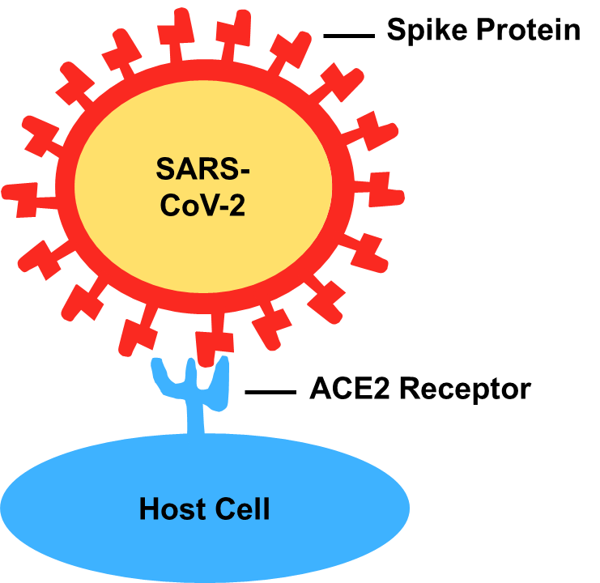

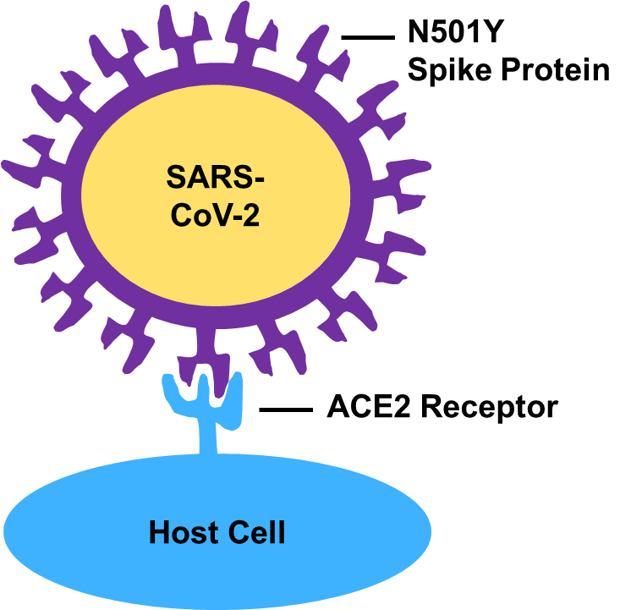
Case Study: N501Y Mutation
WUHAN
N501Y
Article - https://www.ncbi.nlm.nih.gov/labs/pmc/articles/PMC7418704/
Notes:
To recap a little basic virology for SARS-CoV-2, the Spike Protein is a protein embedded into the virus’s membrane which is used to attach to a protein in our own cell membranes called the ACE2 receptor. After the virus binds to that receptor, it can use the channel to insert it’s RNA into our cells and begin the infection. The catch here is that the binding of the Spike Protein to the ACE2 receptor is not a perfect match. Subtle structural differences between the two proteins create an imperfect binding that has a chance to disrupt or prevent proper binding to our cells. However, several articles came out towards the end of 2020 noting the presence of some viruses which had a mutation in the Spike Protein called N501Y (this means the 501st amino acid in the protein used to be an Asparagine, but after mutation became a Tyrosine). Running some lab-tests revealed that this mutation was improving the binding effectiveness of the Spike Protein to the ACE2 receptor, which could improve the mutant viruses’ pathogenicity and therefore infect more individuals. Today, many of the viruses sequenced contain the N501Y mutation. So, for today’s workshop, I am going to ask you to verify the presence of this mutation in a recent sample deposited at NCBI.

Slide 17
Case Study: Our Objectives
Objective 1 - Build a consensus sequence from SRA reads and align to reference genome using AWS EC2 instances
Objective 2 - Search SRA metadata using Athena
Objective 3 - Visualize Sequence Alignments using the NCBI Sequence Viewer
Paper - https://www.ncbi.nlm.nih.gov/pmc/articles/PMC5778042/
Notes:
Now to accomplish this task, we are going to break the workshop into 3 objectives. First, we’ll set up the actual analysis of our genome, including how we use the cloud to set up the computer we want to do the analysis on, how to install the software, and of course, how to get the data from NCBI.
In Objective 2, we’ll take a small detour and explore how you can learn more about the data stored in NCBI’s Sequence Read Archive database using a cloud tool called Athena.
And finally, in Objective 3, we will take the results we made in Objective 1 and visualize them using an NCBI tool called Sequence Viewer. This is where you will be able to see exactly which mutations are in our example genome and try to scope out that N501Y mutation.

Slide 18
Objective 1 – Consensus Sequences from SRA reads using EC2 instances
Notes:
So I’m going to pause here for any questions about the story and today’s goals. But once we’re all on the same page we can jump into Objective 1!
Okay, so in this first objective, we are going to use our cloud accounts to build a computer whose only job will be to download some data, run some computational analyses on that data, and give us some results files that we can use in later objectives. In AWS, that computer is called an EC2 instance.

Slide 19
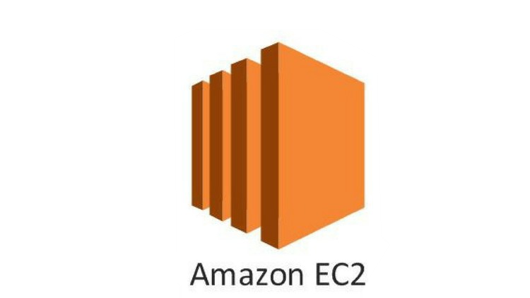
EC2 instance (aka: “Remote Computer”)
EC2 instances basically “remote computers”
Install software, perform data analyses, manage other AWS services using AWS CLI
Lots of different customization options including OS, hard drive space, and memory
Pay for what you use
Price increases with larger hardware needs and longer runtime
Today’s EC2 is roughly $0.20/hour/person
Turn it off when not in use!
Notes:
On a technical level, EC2 instances are the equivalent of renting a computer from Amazon, remotely accessing it online and programming it to do all the heavy data analysis that your own computer would normally struggle with. You can install software, download data, run programs and move your files into other AWS services (like an S3 bucket) all with just a basic internet connection.
Lots of customization,
Pay for what you use.
The cost to keep an EC2 instance running is pretty significant in the context of cloud computing, so you definitely want to keep it turned off when you aren’t actively doing work on it. However, any data stored on the instance cannot be retrieved unless the instance is online. So, rather than turning it on/off all the time, just make a habit of sending your data back to your S3 bucket when you’re ready to turn the computer off. This makes getting the data cheaper, and more widely available.

Slide 20
Building an EC2 Instance Walkthrough
Notes:
So let’s pause the slides again and go prepare our EC2 instances. They take a minute to become ready after we’ve “created” them so we will get them started then come back and talk more about specifically what we will do with those computers.

Slide 21
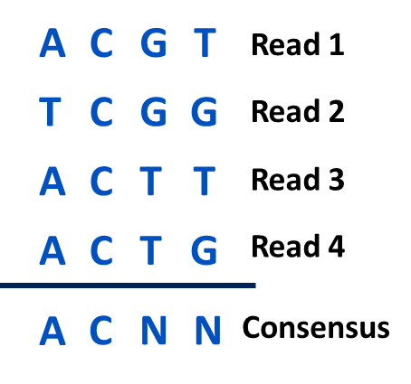

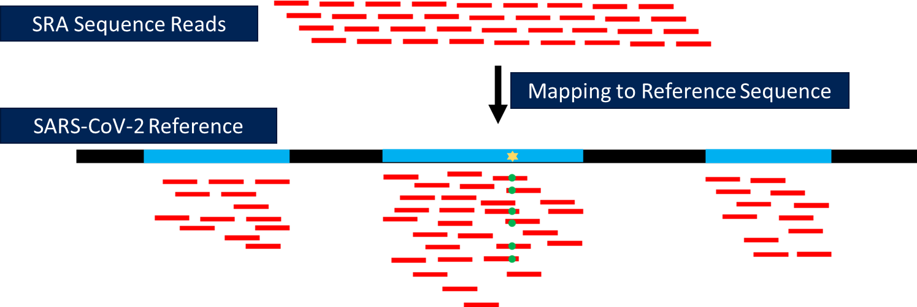

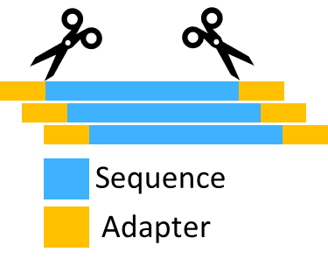

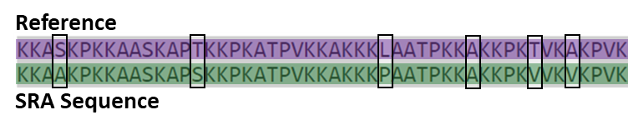
Analysis Pipeline
NCBI Reference Sequence
Hisat2
iVar
SRA
Toolkit
SRA Sequence Reads
MAFFT
Trimmomatic
Notes:
Okay, so what are we actually going to do with this computer? Well, a lot actually! But we’ll try and keep the process simple. First of all, we need to download the data. That means we need a copy of the reference sequence and a copy of the sequence reads for our newly sequenced Sars strain. The Reference sequence can be downloaded with just a link to the NCBI website which I’ve found for you. Now the sequencing data is stored in the SRA database, and to get that we will use a tool called the SRA toolkit. This is the most popular method for downloading sequencing reads from the SRA database, and it comes equipped with methods for downloading sequences on the cloud as well to keep it as efficient as possible.
Once we have the SRA reads, we need to trim the sequencing adapters off of them. We’ll use a tool called Trimmomatic to do that. With our cleaned up sequencing reads we can then align the reads against the reference sequence in order to figure out which parts of the SARS genome each read originated from. Afterwards, we can take the location of each of those reads and build something called a consensus sequence for our data. As the name suggests, a consensus sequence is a single end-to-end genome composed of the most likely nucleotides at each base in the genome. The trick to building a consensus sequence is that many reads are likely to overlap at points on the reference genome during alignment as you can see in this graphic. So, when our tool, iVar, is building the consensus sequence, each nucleotide of the final genome needs to consider what every overlapping read claims should be there and generate… well… a consensus! The point here is after digesting all of that read data, we should be left with a single complete genome which we are expecting is the same genome that was originally sequenced back when the wet-lab researchers did the sequencing.
And with that final complete genome, we then align it against the reference sequence one final time in order to identify all of the nucleotides in our genome that differ from the reference sequence. If and when we find any mutations in that final genome, we can investigate them further to find out if they fit our expected mutations.

Slide 22
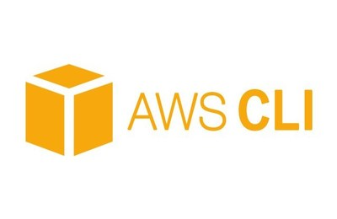
Supporting Software
Samtools
http://www.htslib.org/doc/
Manipulate Hisat2 files into formats usable by iVar
Amazon Web Service Command Line Interface
https://docs.aws.amazon.com/cli/index.html
Moving data between EC2 and S3
Notes:
Now, along with all of that we will also install a few supporting programs to help things along. The first one is called Samtools which will help convert the data we get from the Hisat2 program into a format that can be used by iVar.
The second program is the “AWS CLI” or “Amazon Web Service Command Line Interface”. This is basically a code-based method of interacting with all of the AWS services at once (as opposed to doing it from the webpage like we have done today). We’re going to install this so we can quickly move all of the files we get from our analysis off of our EC2 instance and into our S3 bucket.

Slide 23
Objective 2 - Goals
Computational:
Create, customize, and manage an EC2 instance
Align sequence reads, generate a consensus sequence, and align genomes
Upload files from your remote instance to your S3 bucket
Case Study:
- Identify novel mutations in our recently sequenced genome compared to the traditional Wuhan strain.
Notes:
So like before, let’s recap on our goals for this objective. We will be...

Slide 24
POLL!
How familiar are you with using a Unix command line (aka: terminal)?
Notes:
Now, one last thing before we go play with our instances, I’d like to ask you all how comfortable you feel with using a command line terminal. It can get a bit complicated if you’re unfamiliar with some commands, so I want to make sure we take the proper time to get everyone through this comfortably. Go ahead and fill out the Zoom poll that will pop up like we did before.

Slide 25
EC2 Data Analysis Walkthrough
Notes:
Let’s jump back to our worksheet again and try to log in to our new instances

Slide 26
Objective 2 – Search SRA metadata using Athena

Slide 27
What is the Sequence Read Archive
https://www.ncbi.nlm.nih.gov/sra
Collection of user-submitted nucleotide sequencing reads, most of which are publicly available to download
Current size = >10 petabytes
You can search the data online using the URL above, or by using AWS Athena
Notes:
So we have our analysis going, and if you’ll recall, we grabbed our sequence data from the SRA. Well, let’s talk a bit more about what the SRA actually is. And what other data can be found there.
The Sequence Read Archive, or SRA, is a massive repository of user-provided sequencing data from any organism in the tree of life and even metagenomic or environmental survey sequencing (aka – Sequencing data containing DNA from multiple organisms). In this database, you can find raw sequencing data, and, depending on the quality of the submission, you will also get a decent amount of metadata to help you understand the context of how that data was acquired.
Typically, all this data has been available to search and download from NCBI’s website at the link at the top of the slide, but recently NCBI partnered with AWS to upload all of the 10+ petabytes of sequence data and metadata to the cloud for easier, and often faster, access. To get to this data in AWS, we can use a service called Athena.

Slide 28

AWS Athena
AWS data-table querying platform designed to rapidly query large tables of data using the SQL language
NCBI offers all SRA read metadata as a table we can import into Athena
We can query the metadata with Athena to pull out only useful sequence data to use in our own research
Results can be saved to an S3 bucket
Notes:
Athena is an extremely powerful table-querying platform designed to rapidly dig through large tables of data using the SQL programming language to filter for data that we are interested in.
As part of NCBI’s and AWS’s partnership, all the metadata associated with every submission in SRA is available as a series of tables that can be imported into Athena. This means we can use Athena to narrow down all of SRA using the metadata to find just the data that we might need for our own research.
Then, once we’ve narrowed down the data just enough, we can save those search results to something called an S3 bucket so we can look back at those results later on.

Slide 29
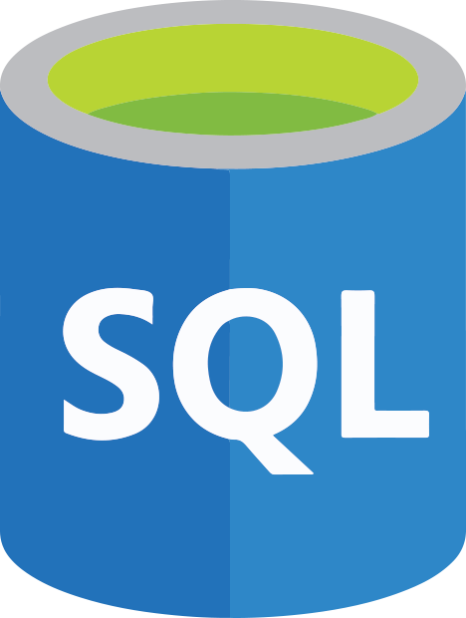
Import results and mine data in table format
Store data mining results and save useful queries
Notes:
At the big picture level, Athena and S3 buckets create a nice, if not simple, workflow where we can import data into Athena from our bucket, filter and search through the data in Athena, then save those customized results back to the bucket for future use. For this objective, we’re basically going to run through this loop once to pull a table of metadata from an NCBI-created bucket, search for the sequencing reads we want using Athena, then save that search result back to our own S3 bucket so we can use it later on.

Slide 30
Objective 2 - Goals
Computational
Use basic SQL commands to query Athena data tables
Save query results to personal computer and an S3 bucket
Case Study
Find sequence data & metadata associated with our sequence reads
Notes:
So, by the end of this second objective, we should be able to:
Create an S3 bucket to save Athena results
Do some basic SQL commands to help filter data in an Athena table
And save those queries to an S3 bucket & your computer so we can look at the results later on

Slide 31
Athena Setup
Walkthrough

Slide 32
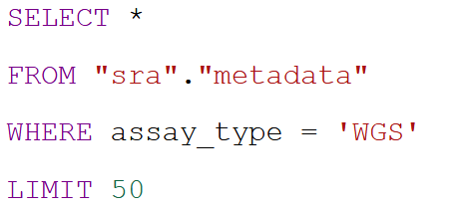
SQL programming language basics
“Give me all of the columns in the table back”
Choose the table columns you want to see for each hit from the table
Choose which table of data you are querying against
Choose the columns you want to filter the data by
Restrict the results to a given number of rows
Notes:
The most basic SQL commands can be broken down into about 4 different parts. The first piece starts with “SELECT” which lets us state which columns in the table we want our results to show. Typically you can list the column header names you want to display after the SELECT keyword, but in this screenshot we show an alternate option which is to use the asterisk key. This is basically code for “give me all of the columns in the table back” and I personally use this most often when I’m exploring data.
The second keyword is “FROM” which, as you may have guessed, tells us which table we want the search to happen in. For this workshop we’ll use the sra data table I prepared ahead of time.
The third keyword is “WHERE” which is where we set the rules about the data we want to see returned. For example, the statement in this screenshot says “only give me the rows in the table that have “WGS” in the assay_type column. Now you can daisy-chain multiple requirements together if you want to get fancy about it, but that won’t be necessary for this workshop.
Finally, the LIMIT keyword is an optional one you can include to limit the AMOUNT of data you get back. For example, if we were to run this particular query against our SRA metadata table we could easily get hundreds of thousands of rows back. However, if we just want a sample of those results we can use “LIMIT 50” like you see here to give us back only the first 50 rows. This is another great keyword to use when you are just trying to navigate and explore a table.

Slide 33
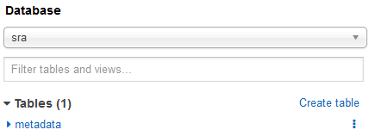
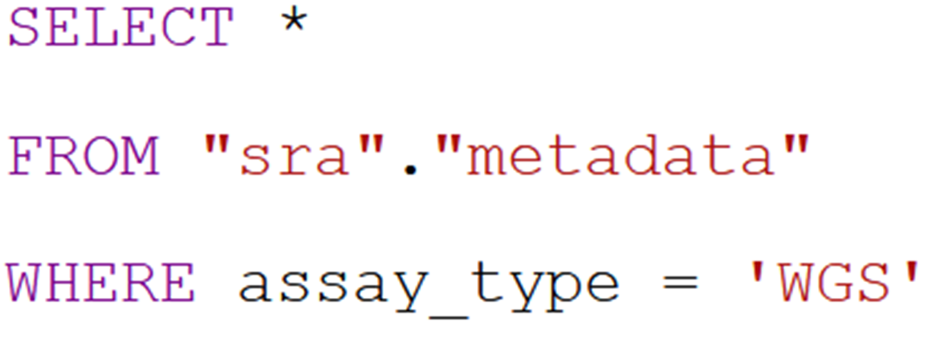
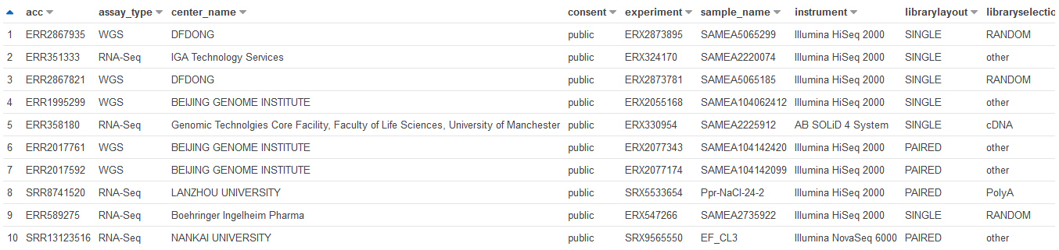
Notes:
We can look at this from a graphical perspective as well, to see everything that happens.

Slide 34
Athena Queries Walkthrough

Slide 35
Objective 3 – Visualize Sequence Alignments using the NCBI Sequence Viewer
Notes:
We’ve made it! The final objective. The goal here is to...

Slide 36
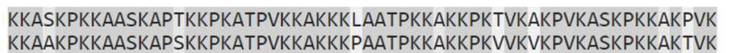
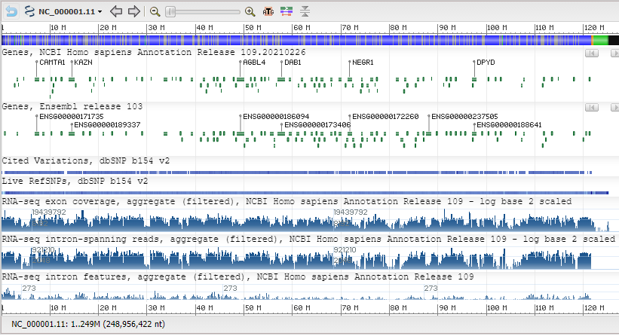
Case Study - Using the sequences
Align Sequences
Reference
Our Sequence
Visualize Alignment
NCBI Sequence Viewer
Notes:
Let’s quickly recap what we’ve accomplished so far. In the last objective we created a consensus sequence for our Virus and aligned that genome to the original Wuhan strain of the Sars-CoV-2 virus to look for any signs of variation. Now we need to take the result files from that analysis and drop them into our S3 bucket. Then, finally, to wrap this process up, we need to actually explore those results to identify those variations we’ve been interested in all along. To visualize these results we’re going to use a tool called the Sequence Viewer.

Slide 37
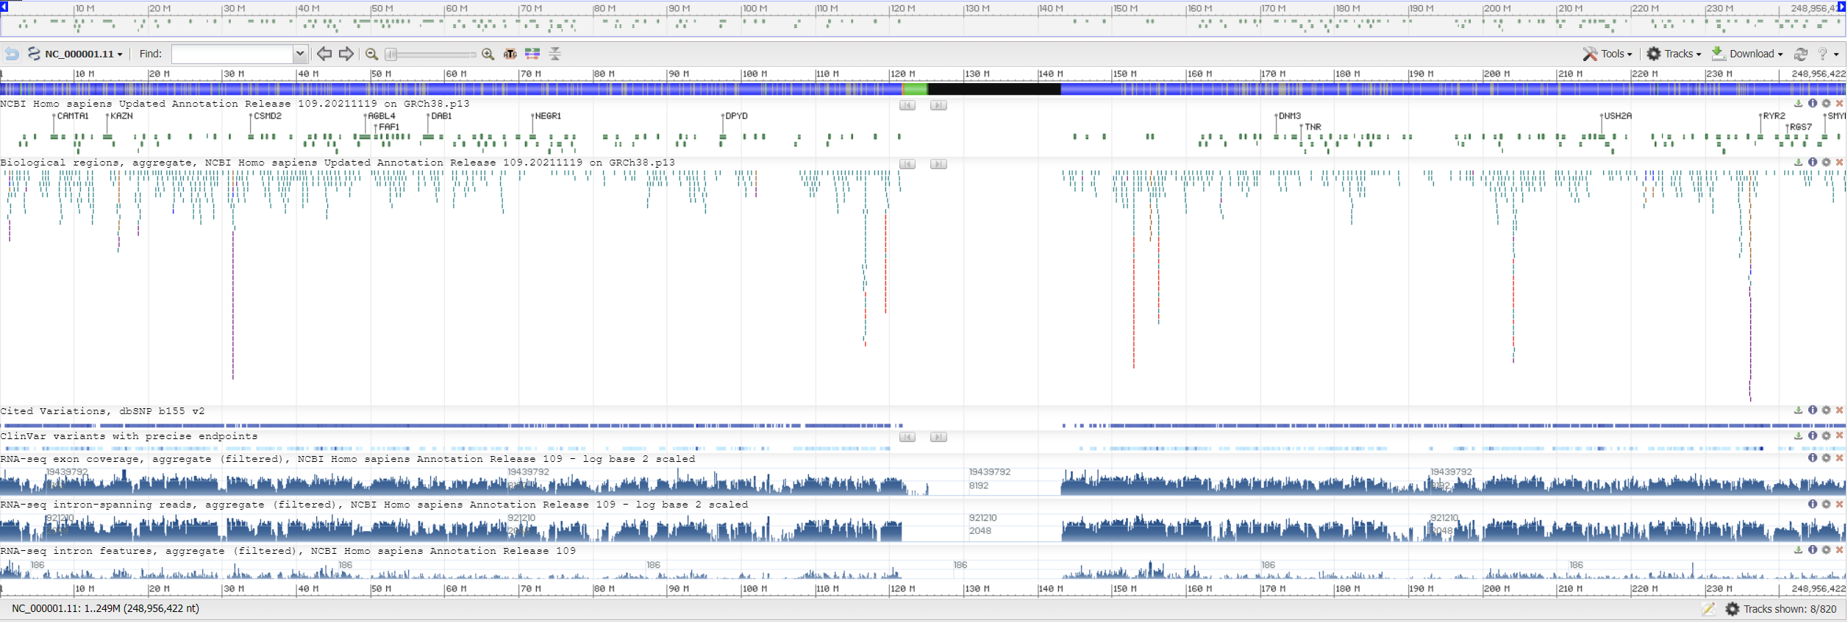
NCBI Sequence Viewer - 1
Sequence Viewer is a web tool which supports the visualization of genetic data mapped against any genetic sequence.
Website - https://www.ncbi.nlm.nih.gov/projects/sviewer/
Notes:
The Sequence Viewer is a web-based “browser” which supports the visualization of genetic data mapped against any genetic sequence you can upload. To get there, you can follow the link in the bottom corner of this slide. It will also be available in the worksheet when we switch back to that soon.

Slide 38
NCBI Sequence Viewer - 2
Data is visualized in “Tracks”
Can include sequence annotations, coverage graphs, GWAS data, alignment data, and more!
Website - https://www.ncbi.nlm.nih.gov/projects/sviewer/
Notes:
The Sequence Viewer organizes data into “tracks” which are small graphical chunks that are aligned with the DNA to visualize a wide range of different data. This could include sequence annotations, sequence coverage graphs, GWAS data, and in our case, alignments between that sequence and others, plus others!

Slide 39
Objective 3 - Goals
Computational:
Access and navigate Sequence Viewer
Upload custom data track to SV
Parse biological meaning from alignment results
Case Study:
Identify variations between the “Wuhan” strain and our own sequence
Compare identified variations to known variations to identify potential pathogenic benefits
Notes:
So for this final goal, we have several objectives we’re going to try and cram together in our final minutes together.

Slide 40
Sequence Viewer Walkthrough
Notes:
For the final time today, let’s go back to our worksheet and complete the rest of this analysis.

Slide 41

Billing
The most important question in cloud computing...
“How Much Will This Cost Me?”
Notes:
Okay, so for a final piece of information today let’s go over the cost of using the cloud. When we talk about the “Cost of Cloud” today we are referring to the per-person cost of using all of these services from getting the metadata with Athena, to storing everything in an S3 bucket, doing the analyses in the cloud with our EC2 instances, and for fun I even threw in the price of importing the SRA data into Athena (the step I did in preparation for this workshop).

Slide 42
POLL!
How much do you think today’s workshop cost per person?
Notes:
<$1.

Slide 43
Billing
The most important question in cloud computing...
“How Much Will This Cost Me?”
Everything you did in this workshop cost ~$0.50
Notes:
The final cost was 0.50 cents a person.

Slide 44
Billing
AWS strives to be transparent about costs
https://calculator.aws/#/estimate - Build a price estimate based on anticipated service usage
https://aws.amazon.com/free/ - View free-tier uses on most AWS services
Several tools such as Cost Explorer can help you break down usage across a group
Notes:
AWS does try to be transparent about costs. They offer several methods to help you manage and estimate your budget for a project.

Slide 45
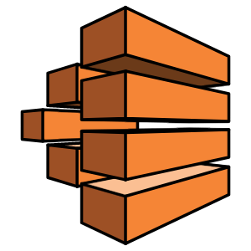

From Introduction to Intermediate & Beyond!
AWS Batch can automate the distribution of work across multiple EC2 instances
AWS Lambda can automate code execution without managing hardware needs
AWS CLI can manage all AWS products from a computer terminal, automating any step of a process
Notes:
And with these newfound cloud abilities at your disposal, I’d also like to clue you in on a few ways to step this process up to a more advanced level should you choose to play around later.
AWS Batch can automate the creation/usage of multiple EC2 instances at the same time. In our example, you can imagine programming AWS Batch to run our analysis over multiple genomes each on their own EC2 instance all at the same time. Without you having to create and manage each one.
AWS Lambda provides an easy way to trigger pieces of code without having to manage any hardware (aka: skipping the entire EC2 instance setup process). This can be useful for automating the start/stop of a piece of code in real-time. For example, AWS Lambda could tell AWS Batch to run another genome just by adding the files for that genome to an S3 bucket. So you can automate your entire data analysis process just by adding data to your S3 bucket regularly.
And finally, AWS CLI is significantly more powerful than what we used it for today. It doesn’t just facilitate the transfer of data in an S3 bucket, it can manage & automate the actions of any Amazon cloud tool. Things like building a quick EC2 instance, running an Athena command, and really anything you would need from the cloud can be programmed to happen rather than point-and-clicking your way through menus.

Slide 46
How do I get an account to try this stuff out?
Initial free accounts can be gotten from:
AWS: https://aws.amazon.com/free/
GCP: https://cloud.google.com/free/
Microsoft Azure: https://azure.microsoft.com/en-us/free/
For NIH-funded research teams, you can also get help from the NIH Strides program: https://datascience.nih.gov/strides/

Slide 47
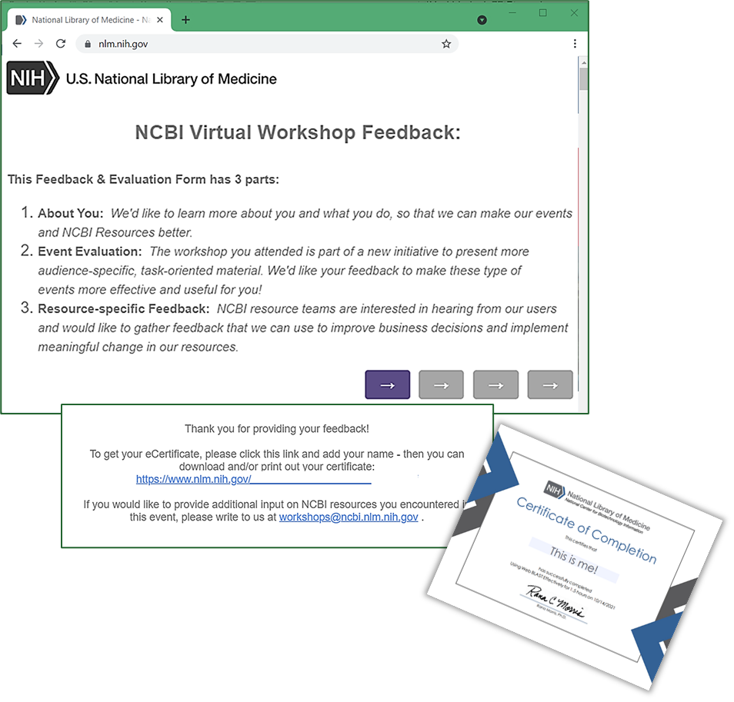
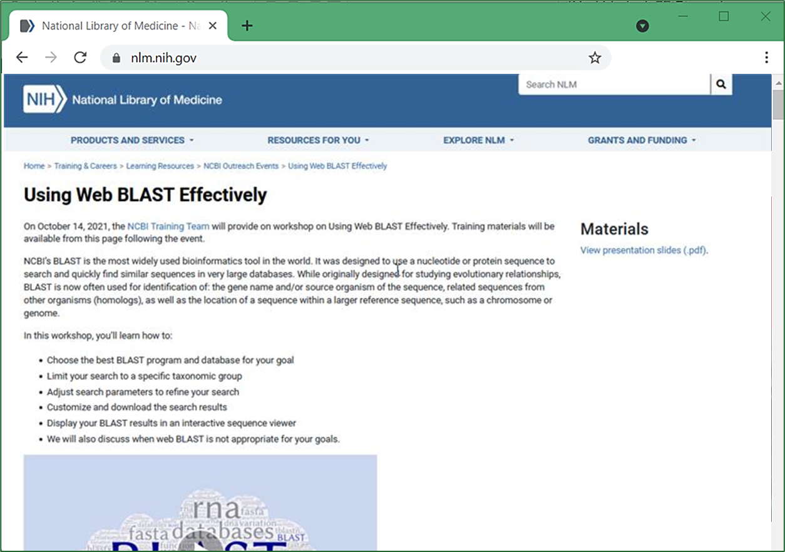
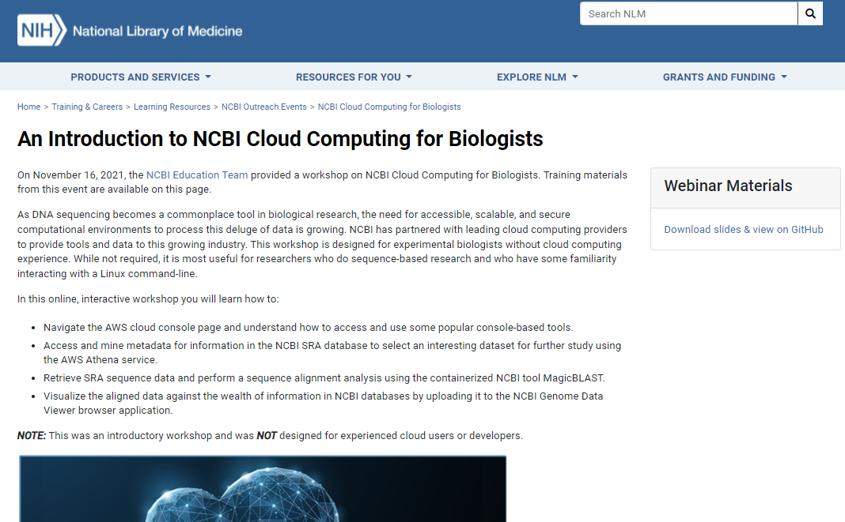
What’s next?
At the end of the workshop, you’ll see a Feedback pop-up to let us know what you thought of today’s event.
You’ll receive a follow-up Email with a link to the Feedback survey as well as a workshop webpage with information about this event and links to materials and the video recording.
This page will also be linked from the NCBI Outreach Events page for this workshop, so you’ll be able to find it later.
https://www.nlm.nih.gov/oet/ed/ncbi/2021_11_cloud.html

Slide 48
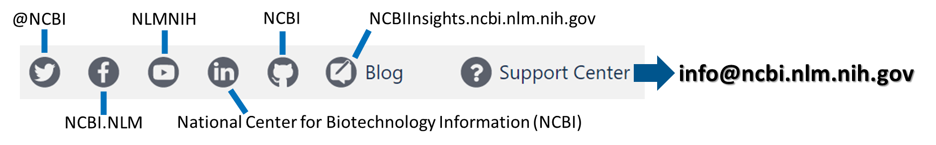
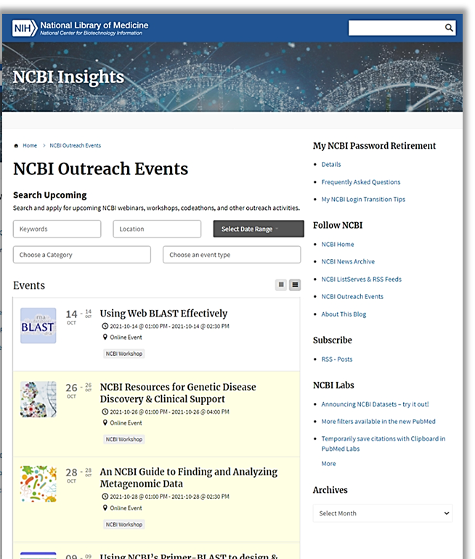
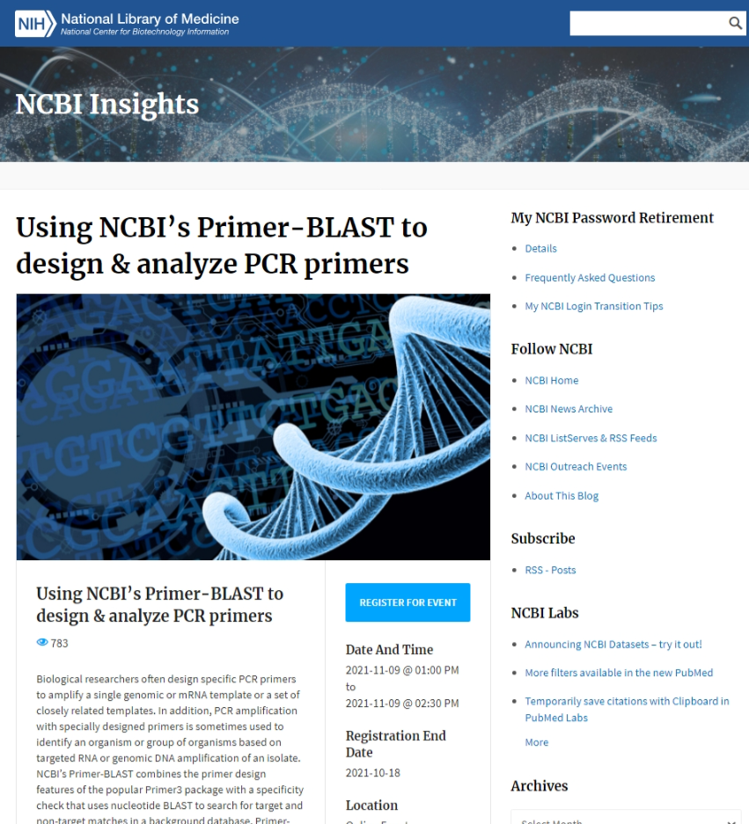

How Can you Keep Up with it all & Learn More?

Slide 49
Thank you!
Notes:
And with that, I’ll say thank you for attending the workshop today. You were all wonderful participants and I hope to see you in another one soon! Rana, I’m going to turn it back over to you to close things out.

